Slide 1


Day 23
contact@anubhavtrainings.com
ABAP RESTFUL APPLICATION PROGRAMMING

Slide 2

Agenda – Day 23
What is RAP (Restful Application Programming Model)
The big picture
Evolution – The developer view
The development flow
Types of Scenarios
Understanding Data Model
Types of Scenarios
Managed Scenario
Unmanaged Scenario
Flow of Development (Unmanaged Scenario)
Defining CDS Views
Creating OData Service ( Business Service)

Slide 3
Types of Scenario
Brownfield Implementation
Is used when we want to create a transactional application which can insert, update, delete data from the system by writing your own logic
You already have Business logic with you and you want to use that business logic to perform transactional capability
You are own your own to manage your implementation.
02. Managed Scenario
Greenfield Implementation
Is used when we want to create a transactional application which can insert, update, delete data from the system by using the framework provided implementation
You do not have Business logic with you and you want system to create business logic for you automatically.
01. Un-Managed Scenario

Slide 4
Flow of Development (Unmanaged Scenario)
Fiori UI
Service Binding for UI
Service Definition
Travel – Using /demo/travel
Projection view- what we want to show to UI
1
N
I_Currency
1
N
N
Agency
Customers
I_Country

Slide 5
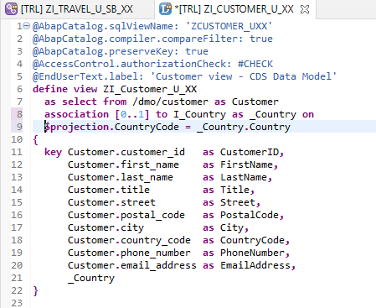
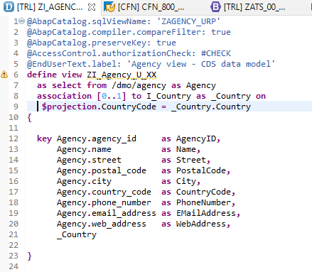
Defining Data Models
Create Customer CDS View “ZI_Customer_U_XX”
Create Customer CDS View “ZI_Agency_U_XX”

Slide 6
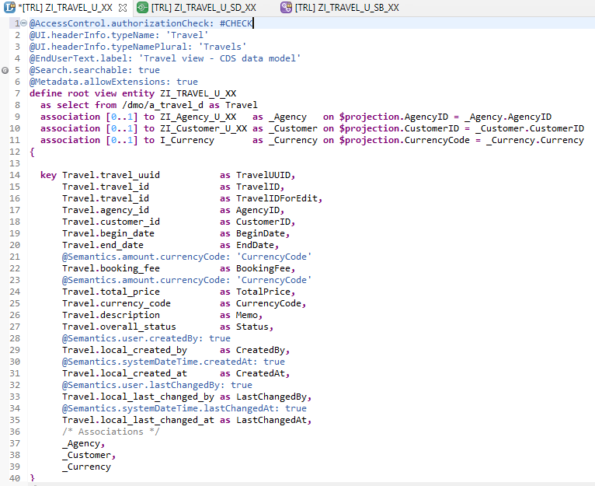
Root CDS Entity
On top of Customer and Agency CDS View we Create Root CDS View EntIty called “ZI_TRAVEL_U_XX”.
With Annotations like Metadata ,Search ,
Semantic Annotation etc.
Association to Agency ,Customer , Currency.

Slide 7
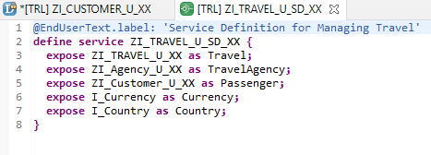
Create OData Service ( Business Service )
A business service definition (short form: service definition) describes which CDS entities of a data model are to be exposed so that a specific business service, for example, Sales Order handling, can be enabled. It is an ABAP Repository object that describes the consumer-specific but protocol-agnostic perspective on a data model. “ZI_TRAVEL_U_SD_XX”
CDS Entity
Service Definition
Service Binding

Slide 8
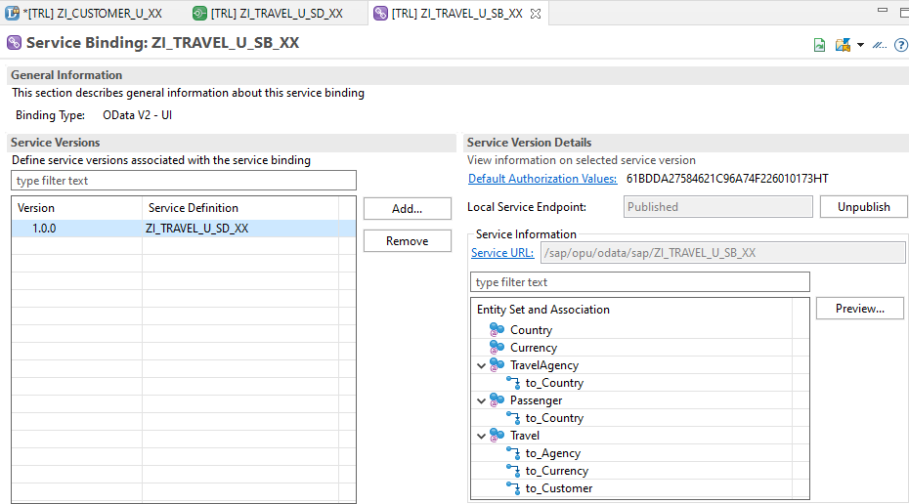
Service Binding ( Business Service )
The business service binding (short form: service binding) is an ABAP Repository object used to bind a service definition to a client-server communication protocol such as OData. Like any other repository object, the service binding uses the proven infrastructure of the ABAP Workbench, including the transport functionality.

Slide 9

End of Day 23
Trainer: Anubhav Oberoy

Slide 10

Trainer: Anubhav Oberoy

Slide 11
THANK YOU
If you cannot do
great things, do small things in a great way.
Anubhav Oberoy
https://www.anubhavtrainings.com

Slide 12


We’re committed to empower you to be
Most Desirable Resource
through powerful training solutions.
We build the workforce of the future.
250+
Corporate Clients
30,000+
Learners Trained
25000+
Learners Placed
FREE WEBINARS
Sign up for free webinars with industry experts every fortnight!
Enroll Now!
Contact us today!
https://anubhavtrainings.com/

Slide 13




More from AnubhavTrainings.com

